Slide 1
Mitigation and Adaptation to Climate Change

Slide 2
How can we address climate change?
Adaptation – Societies making mechanisms to prevent or deal with the impacts of climate change
Can not prevent actual climate change
Shoring up communities in ways that they may be vulnerable to climate change
Think on scale of individuals, organizations, communities, nations, international
Mitigation – Preventing emissions that cause climate change
Stabilization – A portfolio of policy driven approaches aimed at reaching a future climate target (2 degrees change)

Slide 3
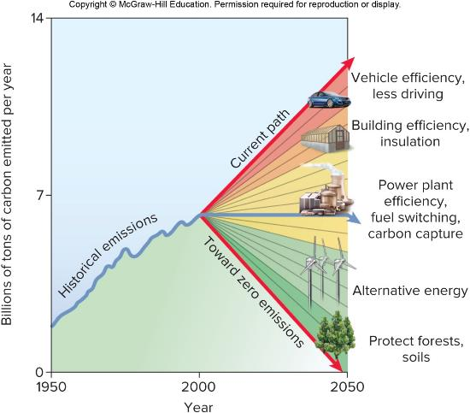
Stabilization Wedges
FIGURE 15.34

Slide 4
Stabilization Wedges Could Work Now
By utilizing Wedge Analysis the problem of climate stabilization can be broken down into smaller, bite-sized pieces.
Need to cut 7 G T (gigatons) over the next 50 years to stabilize climate
Doubling vehicle efficiency, and halving the miles we drive would save up to 1.5 G T.
Installing energy efficient appliances, lighting and insulating building could save another 2 G T.
Capturing and storing carbon emissions from power plants and gas wells could save another G T.

Slide 5
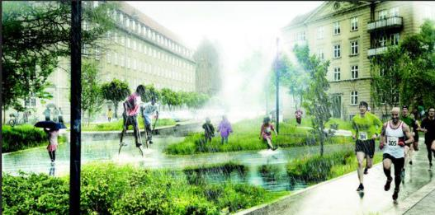
Adaptation
The change is unavoidable.
We need to be able to make societies more resilient to what they will face
This is NOT evolutionary adaption (and that does not work the way you think it does, anyways!)
This is anticipating the vulnerabilities that places will suffer and trying to do things now to prevent that suffering later
Coastal erosion – laws to discourage or prevent building in vulnerable coastal areas, relocating people and infrastructure, protecting mangroves
Coastal Flooding – sea walls, building laws to force mechanical and electrical systems to be located on higher floors, pump systems, culverts and changes to roadways, moving people or infrastructure, evacuation planning
Agriculture shifts – planting drought resistant crops, not planting mono culture crops,

Slide 6
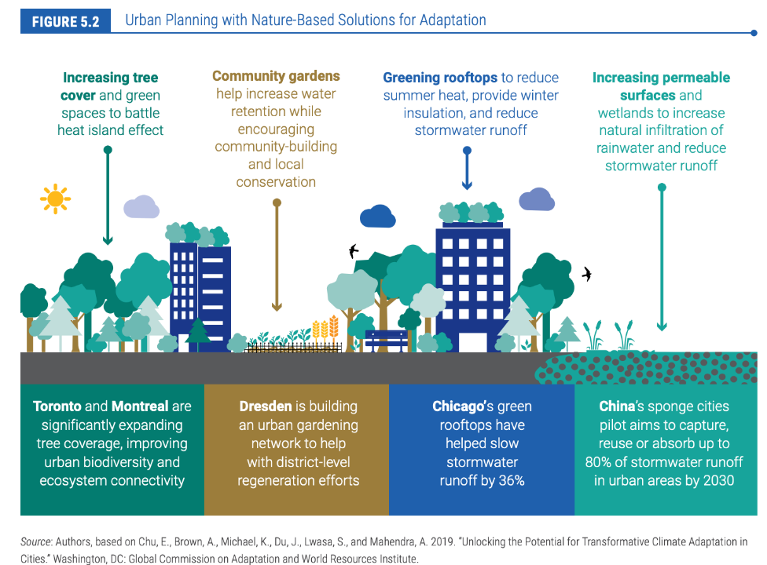
Notes:
Who Drives Adaptation or Resiliency
Individual, organizations, or governments
Governments –if home owners homes are at risk of increased flood damage, would they let their property value decrease or home be destroyed?
A homeowner can not build a seawall to prevent the flooding just to their own home but a community can build a seawall to prevent flooding to a neighborhood
Loss of property value and destruction would eventually lead to community collapse and only those too poor to move would be left, regardless of the damage or risk.
Beneficial to protect the community
Governments can both fund at a larger scale and organize at a larger scale

Slide 7
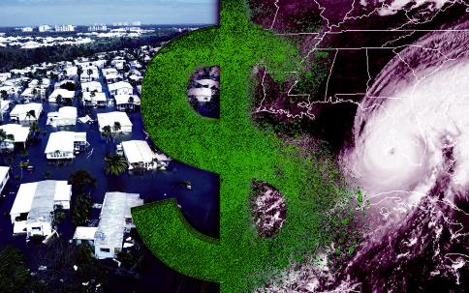
Adaptation
Adaptive strategies benefit everyone no matter where they are applied
Let’s get back to our example of a state affected by a hurricane
There is a massive economic loss and impact from storm damage to major populated areas that effects the whole country

Slide 8

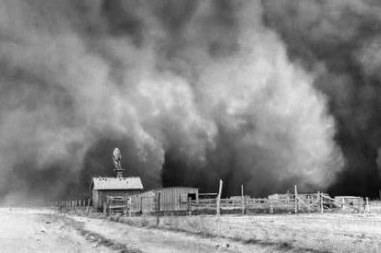
Adaptation
Adaptive strategies benefit everyone no matter where they are applied
Let’s get back to our example of the Nebraska corn farmer
There is a massive economic loss, food insecurity risk, and social upheaval risk of widespread crop failure that effects the whole globe

Slide 9
Adaptation
Example: Dust Bowl 1931-1939 Midwestern USA
Extended drought
unusually high temperatures
poor agricultural practices
All led to wind erosion that made
the Dust Bowl.
-1/3 of all farmers lost their homes
-Homeless, and jobless many migrated

Slide 10
What does Government Policy for Adaptation Look like?
Regulations – laws, statutes, codes
Building codes, flood insurance policy laws
Funding mechanisms for adaptation
Community grants, subsidies, tax incentives
Private – Public Partnerships
Information about Climate Change itself

Slide 11
Adaptation and Equity
Resourced Communities and countries can adapt (to a certain extent)
At the higher end projections of future climate change, wealthy countries today wind up impoverished by the impacts of climate change
Climate change was caused by emissions from lifestyles and consumption from currently wealthy countries.
Built their wealth from activities that ultimately caused this problem
Poor countries can not adapt
Don’t have resources right now to meet the needs of their citizens, let alone the resources to deal with the effects of climate change.
Did not cause this problem
Advancing out of poverty for these countries means increase in consumption, increase in emissions.
These countries are tomorrow’s big GHG emitters
There is a moral issue with the inequity of adapting to climate change

Slide 12
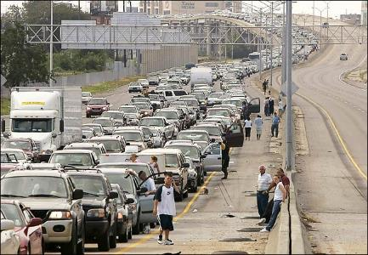
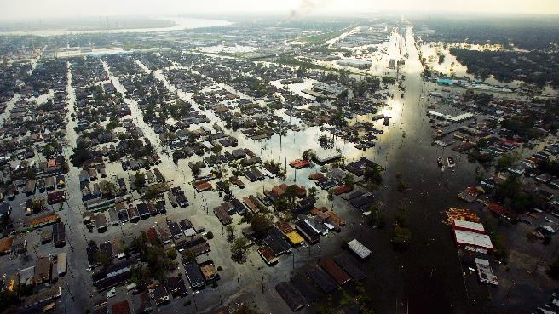
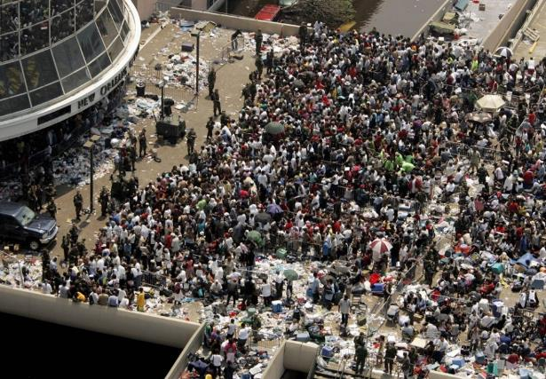
Example: Hurricane Katrina

Slide 13
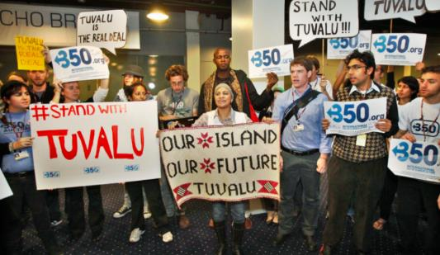
Addressing the Inequity of Climate Adaptation
Green Climate Fund
Set up by the United Nations
Agreed to as part of the Paris Climate Agreement
In 2019 both USA and Australia refused to pay into this
There is a moral responsibility to make adaptation equitable but if it fails, the world still suffers
Even the most wealthy nations will be impoverished by climate change

Slide 14
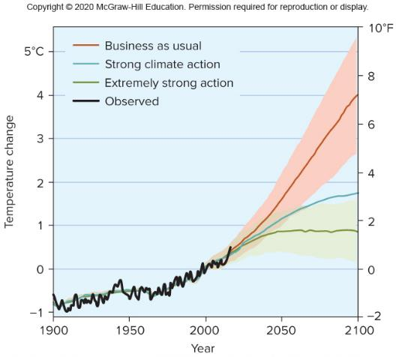
Mitigation
Reduce emissions
This is the center of climate change policy because relying on adaptation is risky
We are in a race
Rate of climate change and its impacts vs. our ability to mitigate and reverse course.

Slide 15
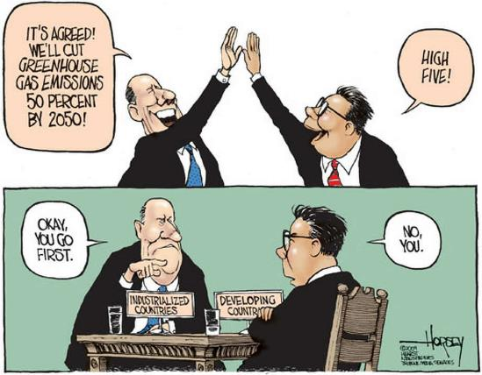
Reducing Emission
How do we reduce emissions?
Focuses on how to move away from fossil fuels as the base of our energy generation and fuel
This is the largest contributor to climate change
Focusing on consumption is a non-starter, most people see consumption tied to well being
Focusing on reducing consumption at a large scale is a political no go – all politicians push for perpetual economic growth

Slide 16
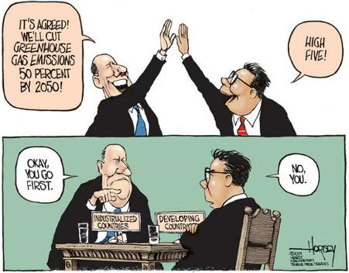
Timeline Problem of Mitigation
This problem is all wrong!
The causes are global (can’t see my own effect) and over lifetimes
The effects are global and over lifetimes
The cost is massive today and doesn’t render a benefit for decades
With mitigation you pay now to benefit in the future
We would see benefits (if we actually did this) somewhere around 2050
Steep political challenge

Slide 17
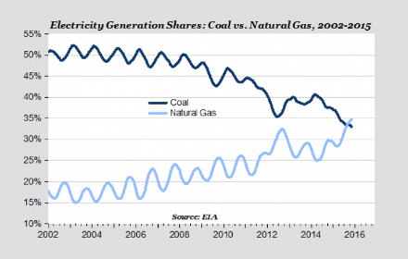
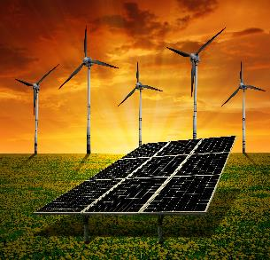
How do we move away from fossil fuels
Move from one type of fossil fuel to a lower emitting fossil fuel
Coal -→ Natural Gas (cuts 80% of emissions)
Move from fossil fuels to carbon free or net zero carbon emitting sources
Renewable Energy: Solar, Wind, Biofuels, Hydropower, Geothermal
Geothermal only generates electricity in a couple of places globally
Most rivers suitable for hydropower already have these dams, no where left to grow this
Clean but non renewable energy: Nuclear
Is MASSIVELY expensive, scary, and takes decades to site a plant due to opposition and cost
Basically takes too long and is too unfavorable to be a realistic solution

Slide 18
What about energy efficiency?
40% of the emissions we have are from built spaces
Using less energy cuts those emissions
Lighting
Heating
Air Conditioning
Plug loads

Slide 19


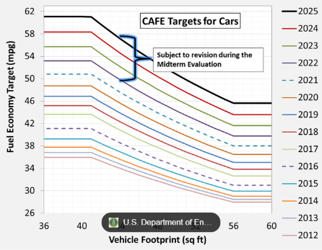
Energy Efficiency in transportation and buildings
Energy Efficiency/Conservation
Doing the same thing, but using less energy
Not using energy at all

Slide 20
The Switch to Renewables Humans Use 15TW of Energy annually
Solar Energy
Wind Energy
To make 15TW of Energy we would need to cover 2% of earth in solar panels
This is about same area that is currently covered in cities
Solar is intermittent!
To make 15TW of Energy we would need to install a few million wind turbines
The best place for these are often offshore
These don’t interfere with using the land for other things
Wind is intermittent!

Slide 21
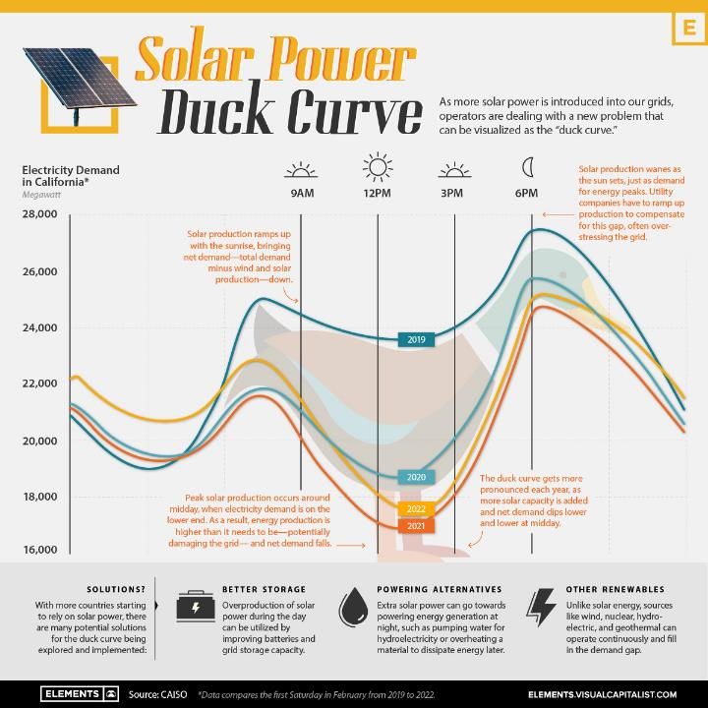

Slide 22
What needs to happen for the fossil fuel to renewable switch to become a reality
Need to have dispatchable power, available anytime on demand
Coal, natural gas, hydroelectric and nuclear can make HUGE loads of power 24/7
Solar and wind make smaller loads of power (individual production sites) intermittently
It has to be used as it is produced!
To solve intermittent production problem
Need industrial sized awesome batteries
Battery technology isn’t there yet ☹
Need to make hydrogen and then use hydrogen to make electricity, or use the energy to pump water up hill to be released through hydroelectric dams at night
This industry is also basically non existent
Need long distance transmission lines
If I’m generating at a time of day when my community wont use the electricity, maybe another community much farther away is hitting peak demand
If I’m in the dark, the sun is shining somewhere else

Slide 23
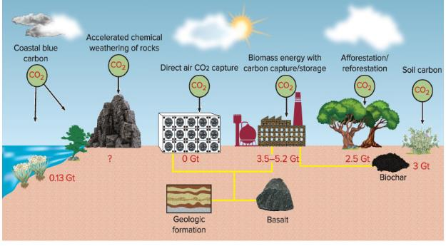
What about Carbon Capture and Sequestration
Would remove CO2 during the production of electricity and pump it underground into pourous rocks
Oil and gas beds that have been depleted
Uses similar technology developed by the oil and gas industry to extract oil and gas

Slide 24
Carbon Capture and Sequestration – Some problems with this!
Would need to divert 10-40% of all energy generated by a power plant to do capturing and storage
Oil and gas beds and other favorable geology is not where our power plants are located
THIS DOES NOT EXIST ANYWHERE!!!
There are no large power plants using carbon capture and sequestration.
The cost of doing this is about the expense of replacing fossil fuel power plants with renewable energy

Slide 25
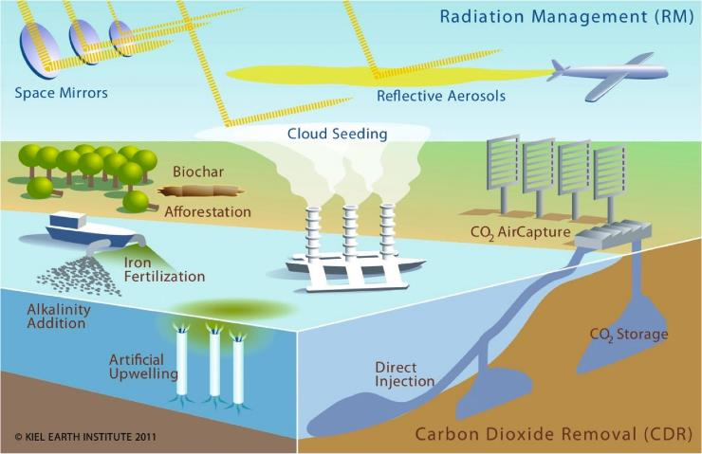
Geoengineer
These ideas are unproven and often controversial
Geoengineering is trying to either prevent incoming radiation or physically remove existing emissions rather than reduce future emissions

Slide 26
Solar Radiation Management
“cancel” the effects of increasing greenhouse gasses by increasing Earth’s albedo
Goal is to reduce amount of energy absorbed by the Earth in the first place
E_{in} = S(1 - 𝛼)/4
E_{in} = Energy that Earth absorbs
S = solar constant
𝛼 = albedo

Slide 27
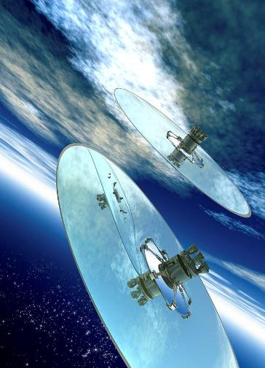
Solar Radiation Management
Reduce S by putting lots of mirrors into orbit in space

Slide 28


Solar Radiation Management
Increase 𝛼 by putting aerosols into stratosphere
SO₂ + H₂ O = sulfate aerosols
High reflectivity
Mimicks what happens naturally with powerful volcanic eruptions
1816 “The Year Without a Summer” – Volcanic eruptions in Europe blocked incoming radiation temporarily such that it was snowing in VT in June and reached -40 degrees C in some places in the winter.
INSERT FIGURE 6.4
Aerosols that would work from this are not “Black Carbon” soot, which increases energy from sun aborbed by Earth

Slide 29
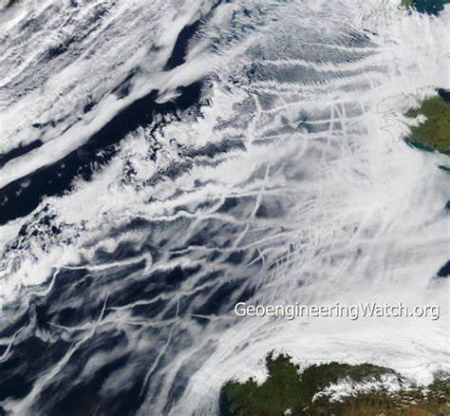
Solar Radiation Management
Increase reflectivity of clouds
Nucleate clouds artificially to produce smaller droplets, which look whiter
This is what ship tracks from planes look like

Slide 30
Solar Radiation Management
Increase reflectivity of clouds
When clouds are created the amount of water stays the same regardless of the number of droplets, if you have more droplets the clouds appear whiter
Water nucleates on cloud-condensation nuclei
Aerosols act as cloud-condensation nuclei
Can put these into the atmosphere to make a cloud and it increases the number of CCNs but the amount of water available is the same
So the droplets are smaller and look whiter
Creates a negative radiative forcing
Immediate temperature reaction

Slide 31
Solar Radiation Management
Increase reflectivity of clouds
Immediate temperature reaction
Relatively cheap
Costs maybe 10B per year
Also creates air pollution
Does nothing to prevent ocean acidification
Shifting T also shifts precipitation unpredictably
Would have to do this continuously as the aersols fall back to earth after a couple of weeks
Stopping would cause a rapid T rise—worse than if we had never done solar radiation management
This is a risky approach with intergovernmental governance issues—this is seen only as an emergency measure—no one wants to do this

Slide 32
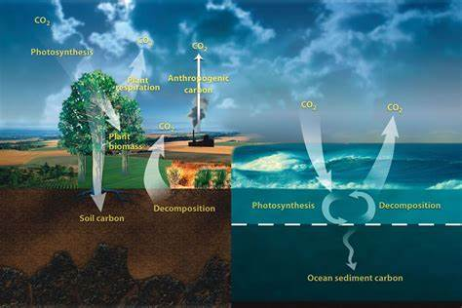
Geoengineering Carbon Dioxide Removal
Goal is to modify the carbon cycle so that carbon dioxide is rapidly removed from the atmosphere faster than natural processes (trees and phytoplankton)
Naturally the carbon cycle would remove the excess over about 100,000 years
Most would be removed within a few centuries
What removes carbon dioxide from the atmosphere
Trees –We can plant more!
Phytoplankton
Water bodies

Slide 33
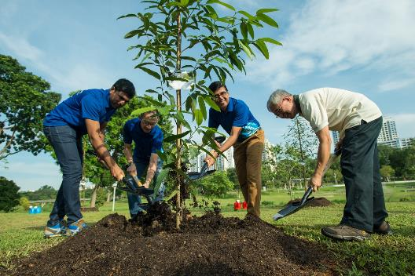
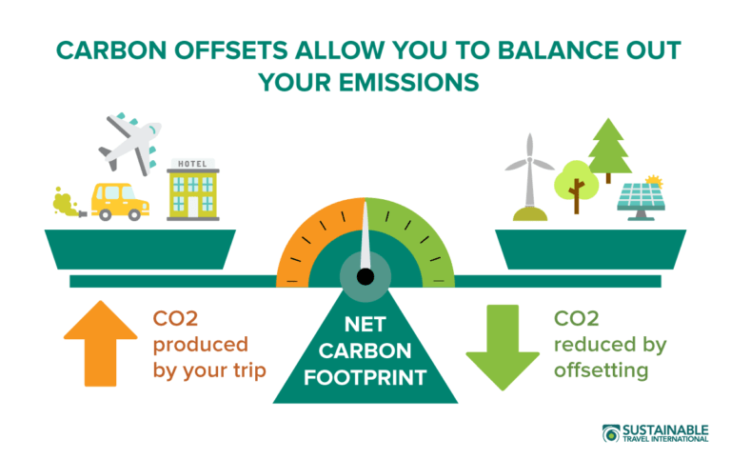
Planting trees isn’t geoengineering, but…
Trees do a great job of taking up carbon!

Slide 34
Planting Trees vs. Geoengineering Carbon Removal
Trees live a few centuries, at best
If the forest burns down it releases CO2 back into atmosphere
If the forest is cut down it no longer is pulling CO2 out of atmosphere
For safe carbon sequestration, you want CO2 out of atmosphere for thousands of years if not longer

Slide 35
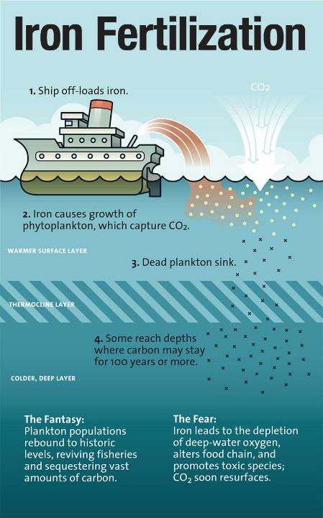
Fertilizing the Ocean
Goal – Increase the productivity of phytoplankton
Add iron to the ocean to act as a fertilizer for the green plants of the ocean to take up, and increase the growth of phytoplankton
More phytoplankton = more photosynthesis
Transported CO2 to deep ocean when phytoplankton are consumed by the food chain
Can’t experiment with this on a large scale without actually possibly disrupting the ocean ecosystem
Studies have shown that adding more may NOT have the desired effect of removing more carbon

Slide 36
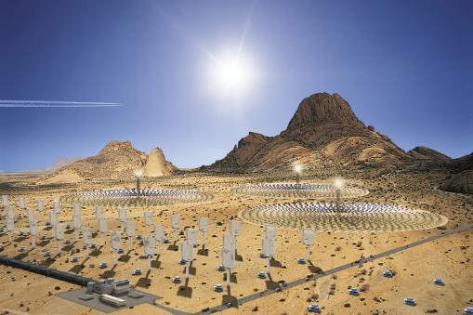
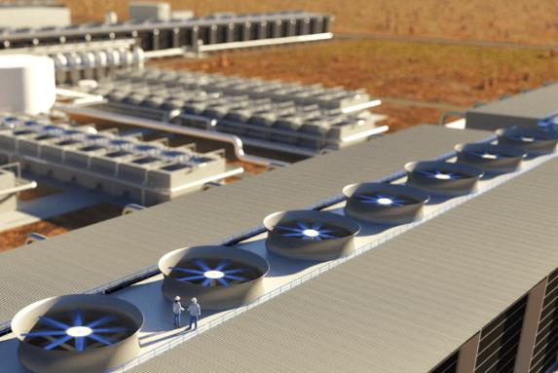
Removing Carbon
Using chemical reactions that mimick the photosynthetic act of pulling carbon from the atmosphere
Install tubes of algae on sides of buildings
“Leaves” of a structure (“tree”) coated in a resin that contains sodium carbonate
pulls carbon dioxide out of the air and stores it as a bicarbonate (baking soda) on the “leaf”.
Can soak up CO2 over and over again
Fans coated in potassium hydroxide (potash), which pulls CO2 out of air

Slide 37
The Intergovernmental Panel on Climate Change (IPCC) warned that we limit global warming to 1.5C by 2100
Need to remove 10 gigatonnes of CO2 per year by 2050, and by the end of the century that number needs to double to 20 gigatonnes per year
Right now we are not really removing much at all, we need to scale up from zero
Will need some combination of adaptation, mitigation, international cooperation, and maybe some technological solutions (but don’t wait for these to scale from zero!)

Slide 38
Government Policy Approaches to Climate Change
Regulation
Carbon Tax
Cap and Trade
Offsets
Consumer Driven (Information)

Slide 39
Government Regulation vs. Free Market
“I have always believed that the marketplace does work. It works because it’s based on one fundamental dynamic, which is self-interested of an individual, a company or a country. The marketplace fosters competition and always trends towards producing a better, cheaper product, which means it is a driver of efficiency. It is in the interest of everyone here to make a cheaper product that is less energy intensive. It cleans up the environment which ahs economic advantages too.” –US Senator, Chuck Hagel

Slide 40
Why Free Markets will only lead to more climate change
1) Emissions Reductions don’t happen by themselves
2) Externalities lead to “market failure” --costs that are imposed on people who are not a part of the transaction –not the buyers, not the makers
I produce an object for $10 and the emissions from producing that object cause $2 worth of damages environmentally.
The cost of that object is $12 but the manufacturer only pays $10.
The $2 of cost damage is borne by everyone in the world. (Health problems, degraded property value, environmental harm)
The benefit to producing the object only goes to the manufacturer.
If you could make the same object for $11 with no emissions it benefits the economy to not have to deal with the externality of the environmental damage.
But why would the manufacturer switch? It is more expensive to them.

Slide 41
Why Free Markets will only lead to more climate change
1) Emissions Reductions don’t happen by themselves
2) Externalities lead to “market failure”
3) Free market works in the interest of individual players
4)You need government intervention or otherwise it is only free market at work and we accelerate to 4+ degrees C by the end of the century

Slide 42
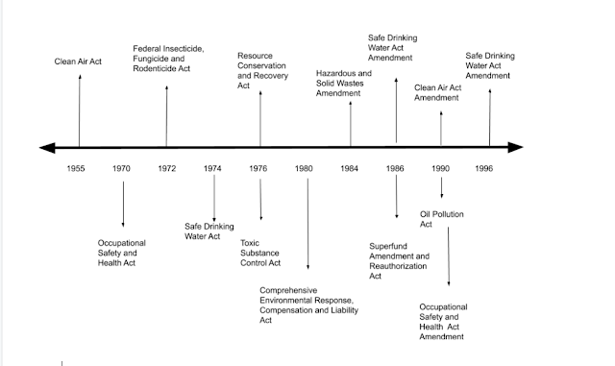
Regulation
“Command and Control”
Government passes laws or “standards” that have to be met
Ex. Require a certain amount of renewable energy to be generated by electrical utilities by a certain dat
They do not have a choice to do this, but may be creative in how they execute
CAFÉ Standards (Corporate Ave. Fuel Economy)
Renewable Energy Portfolio
20% by 2020
Would be a penalty for not complying

Slide 44
Market Based Regulations
Carbon Tax – puts a price on carbon emissions
charge for each tonne of emissions released
Works by placing the tax on the fuel
cost passed to consumers
Assumes that non emitting technology doesn’t raise prices
Marginal Cost = the cost of reducing a particular ton of emissions
Emitters reduce until the margin cost of emissions equals the cost of the tax
Lets assume you are a power plant operating in an environment with a carbon tax
If it costs $1/ton for the reduction and $4/ton for tax
then the emitter is going to seek to reduce emissions
If it costs $4/ton for the reduction effort and $4/ton for tax
then the emitter is still likely to seek to reduce emissions
If it costs $5/ton for the reduction effort and $4/ton for tax
then the emitter is still likely to just pay the tax

Slide 45
Market Based Incentives
CAP and TRADE –government issues fixed number of permits to pollute each year allowing a holder to emit a fixed amount of greenhouse gases.
Total number of permits Is the cap on emissions.
Emitters with extra permits (they emit less than other plants) sell their permits to emitters who emit more.
This adds extra operational costs and encourages inefficient plants to upgrade or shut down.

Slide 46
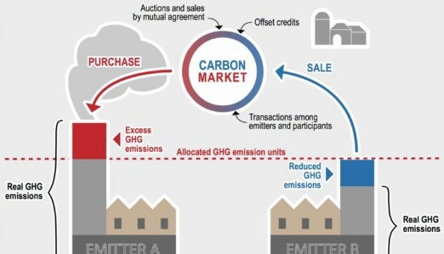
Cap and Trade

Slide 47
Cap and Trade
An example of this might look like
Assume you are a power plant
If margin cost of reducing one unit of CO2 is less than the permit cost, the emitter will not emit that tonne (they will strive towards reduction of CO2).
They wouldn’t have to buy a permit or they could sell their permit for a profit
If the margin cost of reducing one unit is more than the permit cost, the emitter must buy a permit and will emit that unit of CO2
The emitters reduce until the margin cost is the cost of the permit. Can raise the cap through time
When a unit of CO2 is emitted the permit is retired (so you would have to buy more to emit more)
Government could auction off the permits and companies pass cost to consumers
Government can have a “valve” to loosen or tighten cap or permit price

Slide 48
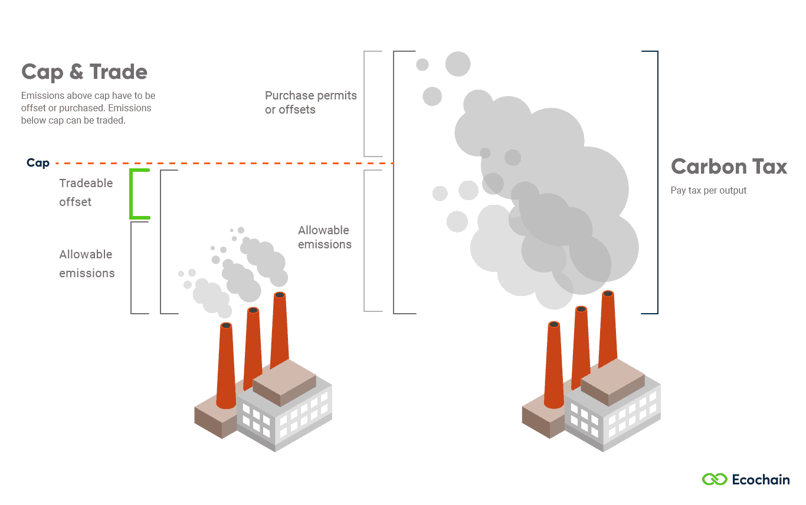
Cap and Trade vs Carbon Tax

Slide 49
Cap and Trade vs Carbon Tax
Carbon Tax – we know the cost of the reduction but not how much would be reduced
Cap and Trade – we know how much would be reduced but not the cost to do so

Slide 50
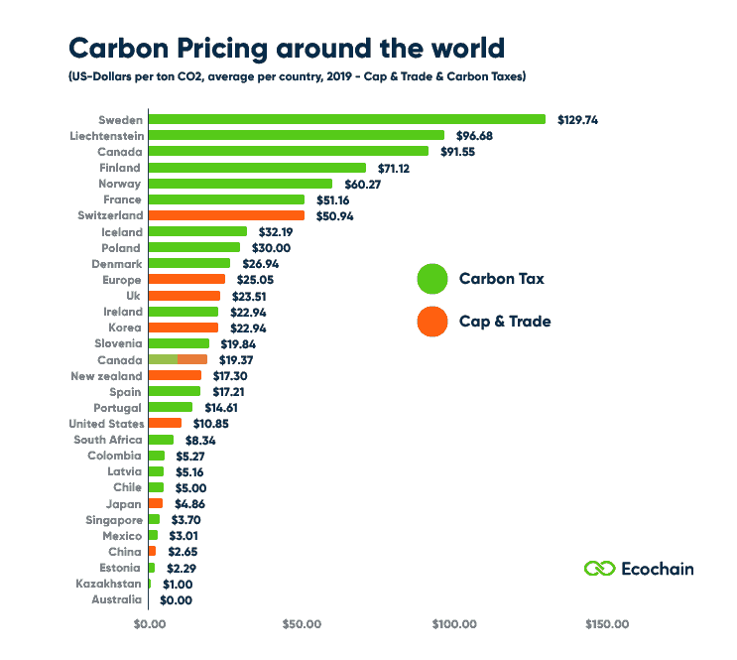
Both put a price on carbon emissions
Both raise the cost of fossil fuels
Both raise the cost of energy made with fossil fuels

Slide 51
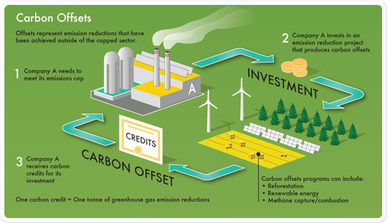
Carbon Offsets

Slide 52
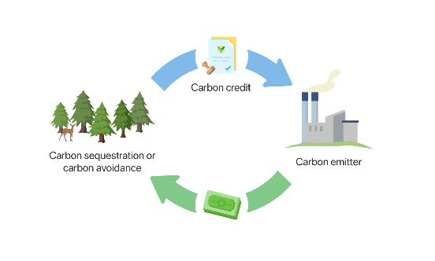
Carbon Offsets
Buying tree planting to absorb the amount of CO2 emitted and “offset” emissions
Goal is to create “negative emission”—offsets
Used to lower the amount of carbon tax paid
May be cheaper than capture technology or efficiency upgrades

Slide 53
Carbon Offsets
Here is why they are difficult—
Verification – How do verify the money to plant trees actually planted trees? That the forest wasn’t cut down? Burns down? Does the owner of the offset have to refund the credit?
Additionality – we need to assure that the trees planted wouldn’t have been planted anyways without payment. Need offsetting action to be tied to the payment of a power plant
Has to be in addition to what would have happened anyways

Slide 54
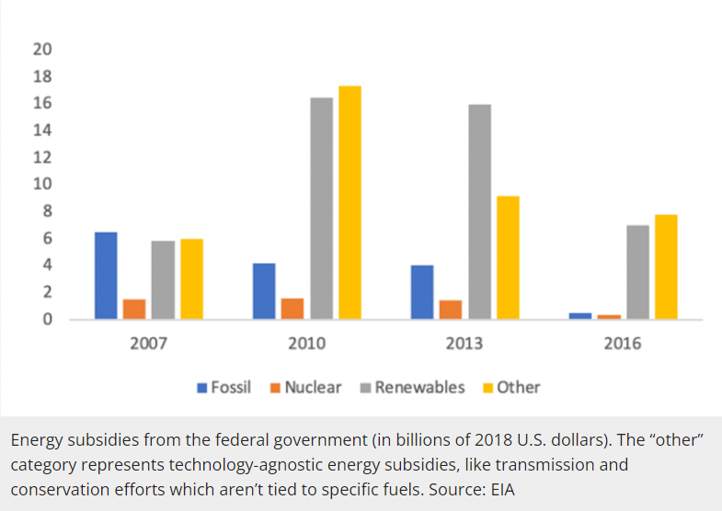
Other Financial Mechanisms to Address Climate Change
Feed in Tariffs on Renewable Energy – longterm stable contracts for renewable energy put on the grid (by property owners)
Subsidies - It can be direct (such as cash payments) or indirect (such as tax breaks). The subsidy is typically given to remove some type of burden, and it is often considered to be in the overall interest of the public, given to promote a social good or an economic policy

Slide 56
Government Action - Information
Puts the onus on YOU to fix the problem caused by emitters
-Convince you that the driver of the problem isn’t the emitter but something else to distract consumers from actually pushing for reduced emissions or changing behaviors

Slide 57
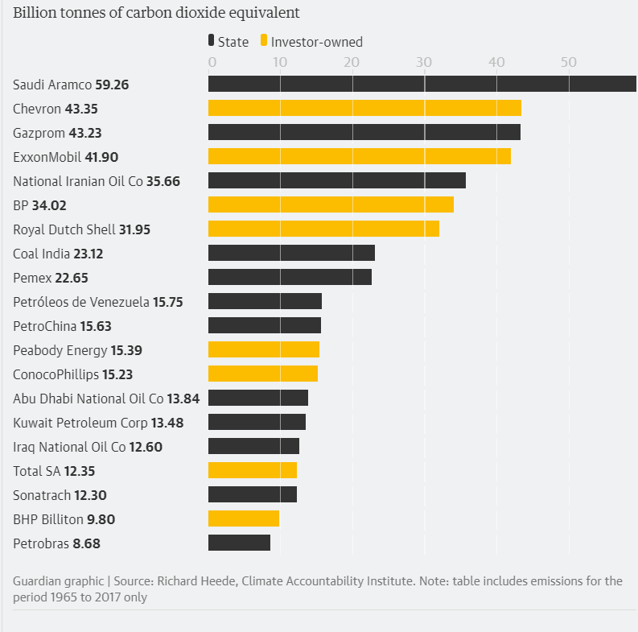
Here is who is responsible for 1/3 of all emissions

Slide 58

Here is what you have been convinced to focus your attention on instead of the 100 companies causing 70% of all climate emission

Slide 60
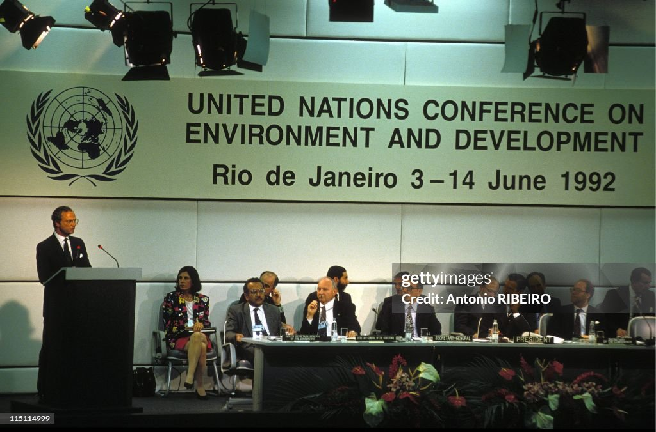
Climate Conventions
1992 Earth Summit in Rio de Janeiro
“Framework Convention”
Near universal membership—ratified by 192 nations (including all big emitters)
Established the building blocks on which future negotiations are built
Goal “achieve stabilization of greenhouse gas concentrations at a low enough level to prevent dangerous anthropocentric interference with the climate system”
Introduced “common by t differentiated responsibilities” –nod to inequities
Expect rich countries to cut emissions before developing countries
Idea is that rich countries have means to cut emissions and can scale technology that can then be used by developing countries
Everyone participates but not at the same time frame or extent
Established the “Precautionary Principle”: Where there are threats of serious or irreversible damage, lack of full scientific certainty should not be used as a reason to postpone such measures.

Slide 61
Climate Conventions
By 1995 it was clear no country was going to meet emissions reduction targets set in Rio de Janeiro in 1992
Original “Framework” was all voluntary
Realized they needed mandatory reductions to be agreed upon
Kyoto Protocol 1997
Emissions from industrialized nations to be 5% below 1990 emissions levels from 2008-2012 commitment time frame
Flexible in how that commitment could be met
Reduction obligations could be exchanged with other nations
Clean Development Mechanism –industrialized countries could invest in emissions reduction projects where it is cheapest typically in developing countries
Have to show that a project would not be built without the financial support from the industrialized nation
Reduction obligations could be met through offsets

Slide 62
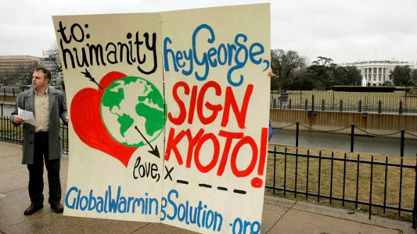
The George W Bush Years
After Climate Talks in Den Hauge, Netherlands in 2000, Bush Administration withdrew from the Kyoto Protocol process.
Painted the “common but differentiated responsibility” as unfair
Caused conflict between rich and poor countries in climate talks subsequently
Federal government took no action on climate but many states did regional greenhouse gas intiatives and climate action planning
Enough countries still ratified the protocol to go into effect in 2005
EU aggressively took actions such as large scale cap and trade

Slide 63
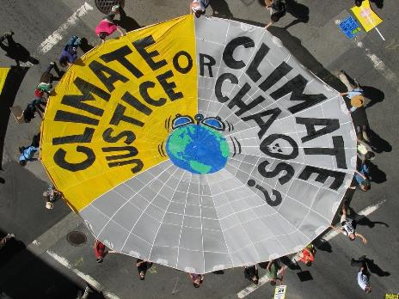
The Obama Years
2009 Negotiation in Copenhagen, Denmark
Marked by disputes between developing and industrialized nations over sharing the burden or action
Copenhagen Accords Included
Global T should not rise more than 2 degrees C beyond pre industrialized levels
Recognized deep cuts to emissions needed
Recognized equity issues
Rich countries set their own 2020 emissions goals, developing countries did not accept specific emissions targets
Political climate in US
Tea Party opposed any government intervention in anything
This turned a number of previously pro climate action Republicans against any climate action (Newt Gingrich, Mitt Romney, John McCain)
Majority Republican control of congress at mid term elections ended hope of climate legislation

Slide 64
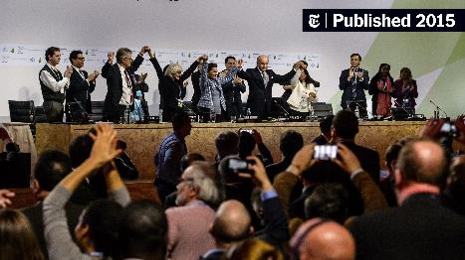
The Obama Years
Paris Agreement 2015
Required nations propose their own climate actions and commitments
Avoided having the problem of everyone having to agree to the same targets
No penalty for missing targets but a “Name and Shame”
US pledged to reduce emissions by 2025 by 26% below 2005 levels, EU pledged 40% cut by 2030 compared to 1990
China signed on to peak emissions by 2030 and decline thereafter
Goal to keep warming by 2100 below 2 degrees C
Seen as success but can’t actually stabilize the climate
Obama submitted “Clean Power Plan” focused on power plants and required states to set targets for emissions reductions through
Energy Efficiency, low emissions (natural gas), renewable energy
Not put into action—Supreme Court shot it down
Many states still followed through

Slide 65
The Trump Years
Environmental Views are now proxy for political affiliation
Ran for president on premise that climate change was a “Chinese Hoax”
Instantly undid Obama’s climate policies upon taking office and withdrew from Paris Climate Agreement
Rolled back fuel efficiency standards

Slide 66
The Biden Years
Paris Agreement requires signers to recommit every 5 years and update their emissions reduction plans
China, Japan, South Korea, and EU/UK would be “Net Zero” by 2050 or 2060
Biden rejoined the Paris Agreement almost instantly
Committed US to reach “net zero” by “mid century”
Climate action
Included climate reduction strategies into “Inflation Reduction Act”
Increased standards for vehicles, power production, and industry
Achieved cutting emissions by 50% from 2005 levels

